Slide 1
Computer Organization & Assembly Language (CSC-205)
Lecture 10

Slide 2
Practise Questions
4.) Write an Assembly program that counts the number of negative
numbers in an array.
Store the result in CX.
The array ends with -1.
Note: Use a loop and check the sign flag (SF) using JS.

Slide 3
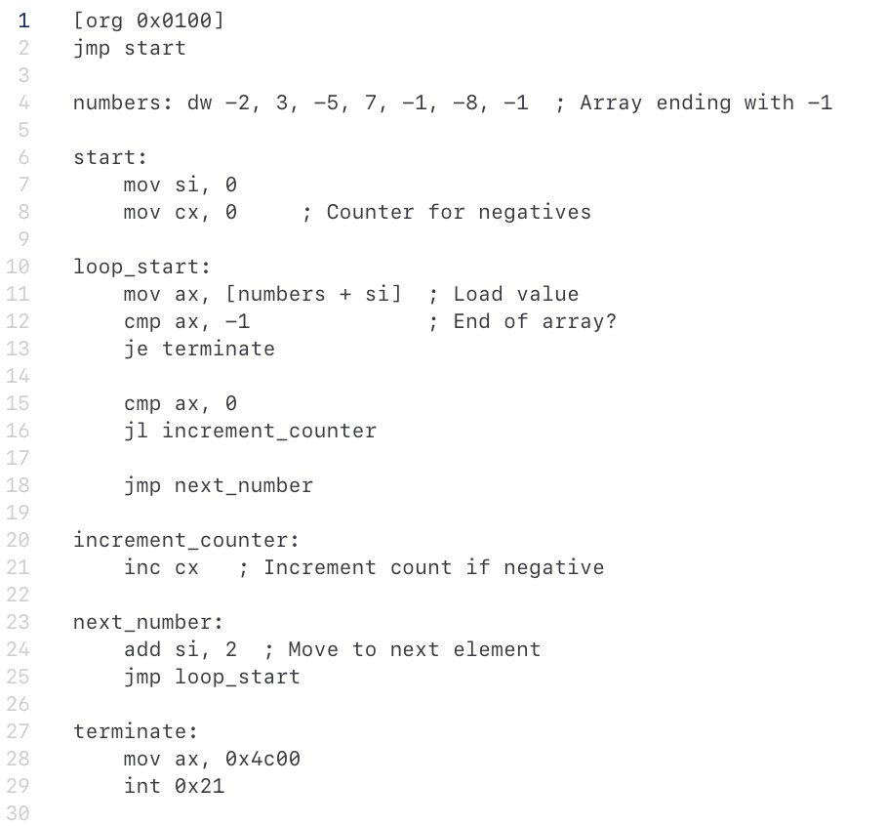
Solution

Slide 4
Practise Questions
5.) Write an Assembly program that swaps two numbers in memory if they are not in ascending order.
Example: If AX = 5, BX = 2, swap them to AX = 2, BX = 5.
Note: Use CMP AX, BX, followed by a jump (JG) to swap.
Notes:
upto this one.

Slide 5
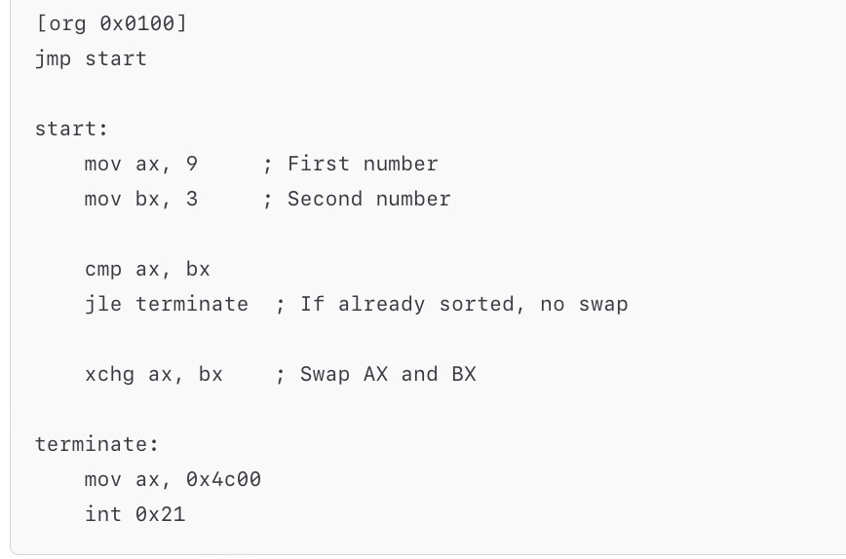
Solution

Slide 6
Practise Questions
6.) Write an Assembly program that scans an array for the first non-zero number and stores it in BX. The array ends with -1.

Slide 7
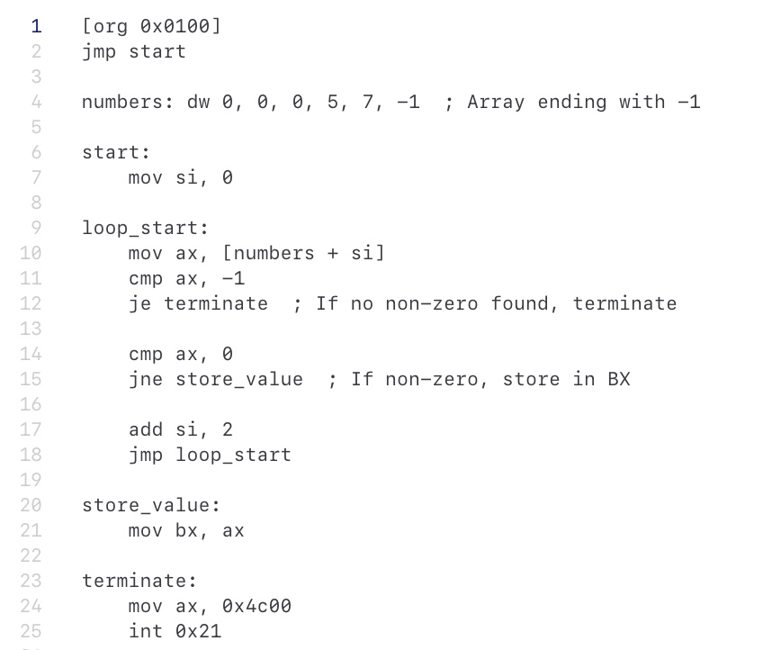
Solution

Slide 8
Practise Questions
7.) Write an Assembly program that takes a number in AX and checks if it is even or odd.
If even, store 1 in BX.
If odd, store 0 in BX.

Slide 9
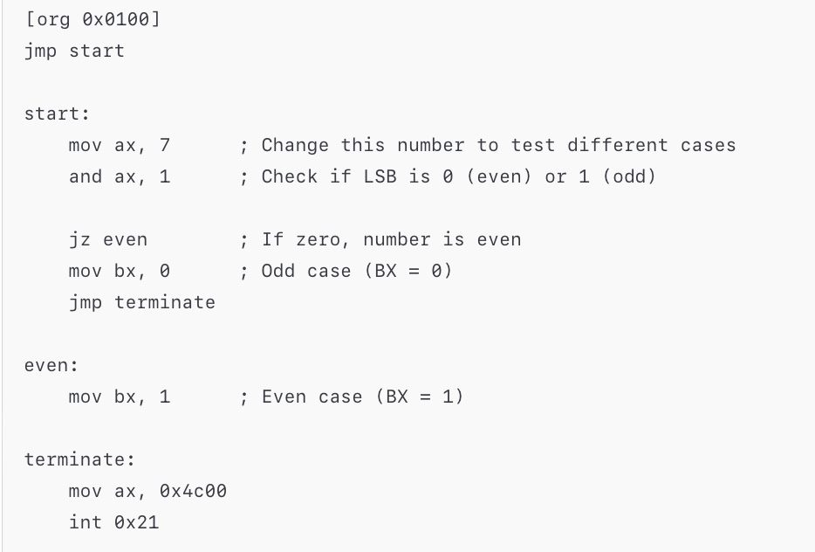
Solution

Slide 10
Practise Questions
Write an assembly program that which finds if an array ‘digits’ is duplicate or not. The array ends on a -1. If the number in the array is duplicate, set bx to 1 and 0 otherwise.
For example:
If digits: 1,1,2,1,1, -1, set bx=1
If digits: 1,2,3,4,-1, set bx=0

Slide 11
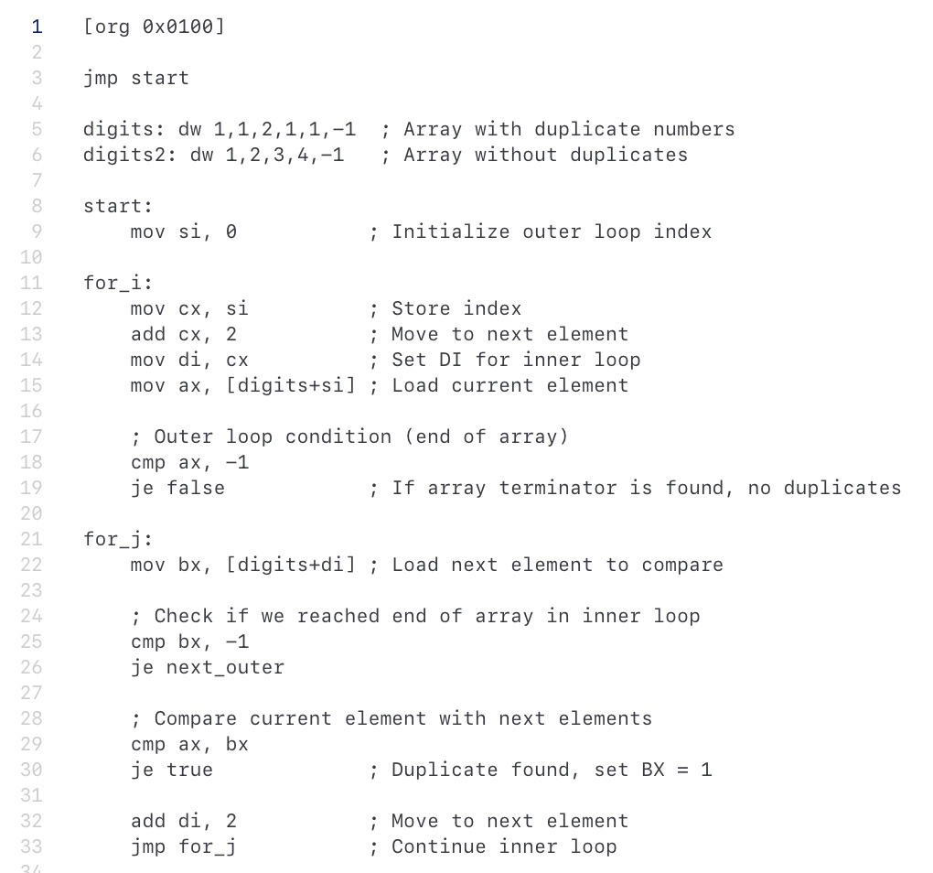
Solution

Slide 12
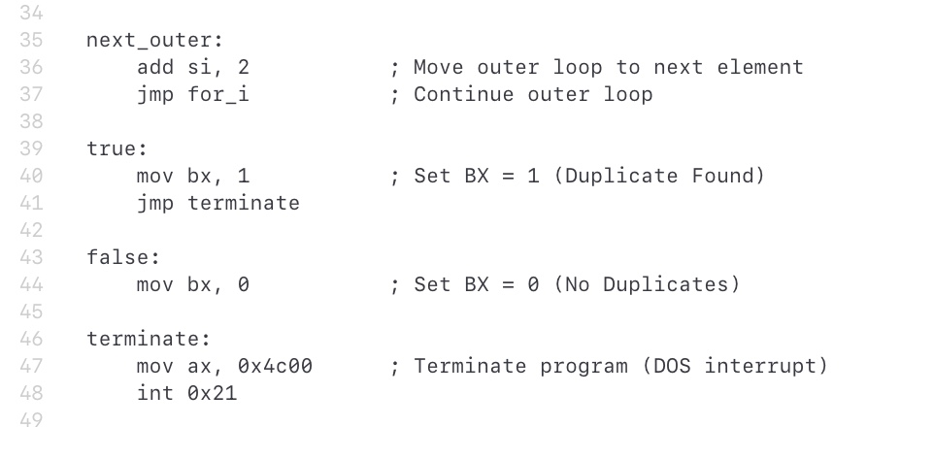
Solution

Slide 13
Practise Questions
Sort a liist of 10 numbers using bubble sort.
data: dw 60, 55, 45, 50, 40, 35, 25, 30, 10, 0

Slide 14
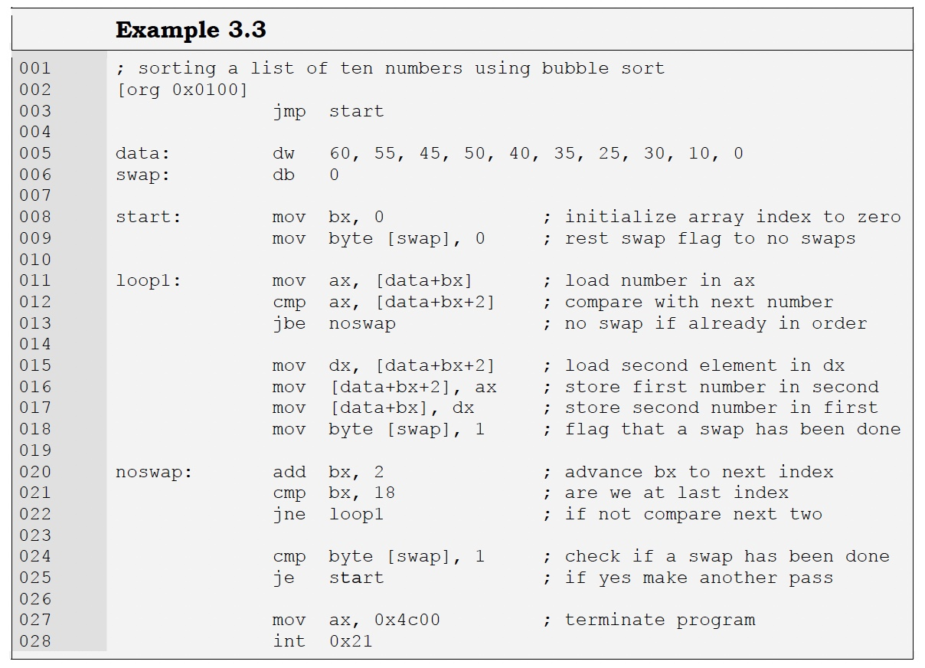
Solution

Slide 15
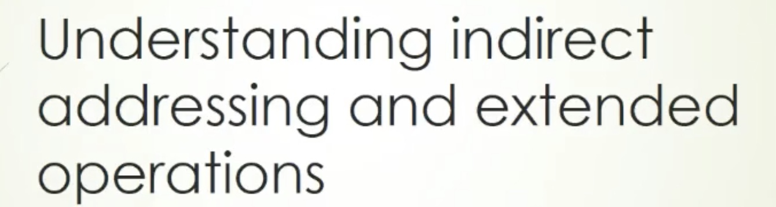

Slide 16
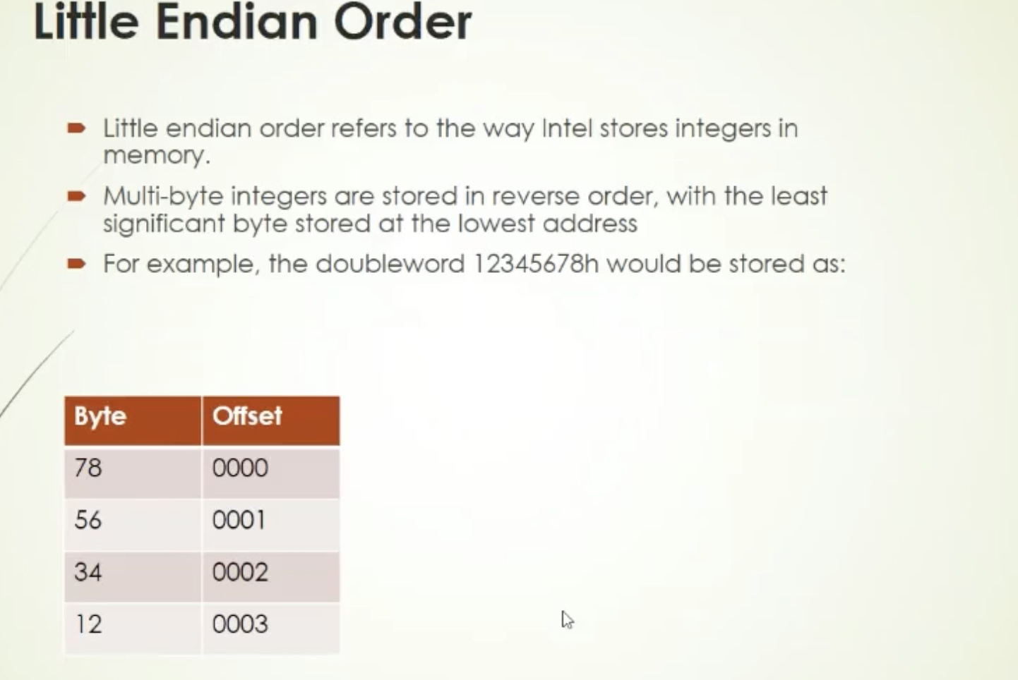

Slide 17
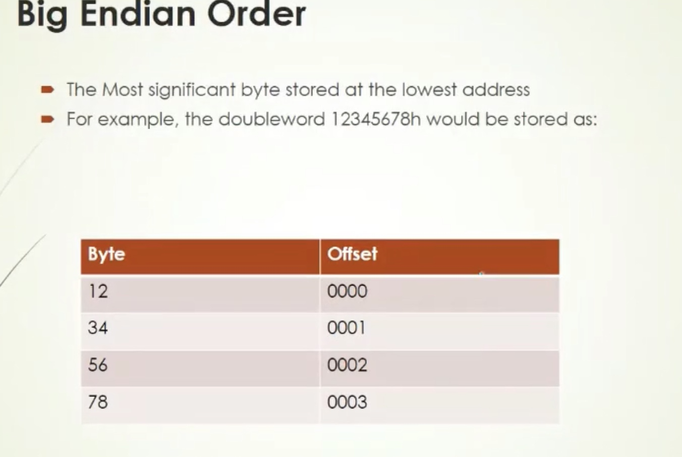

Slide 18
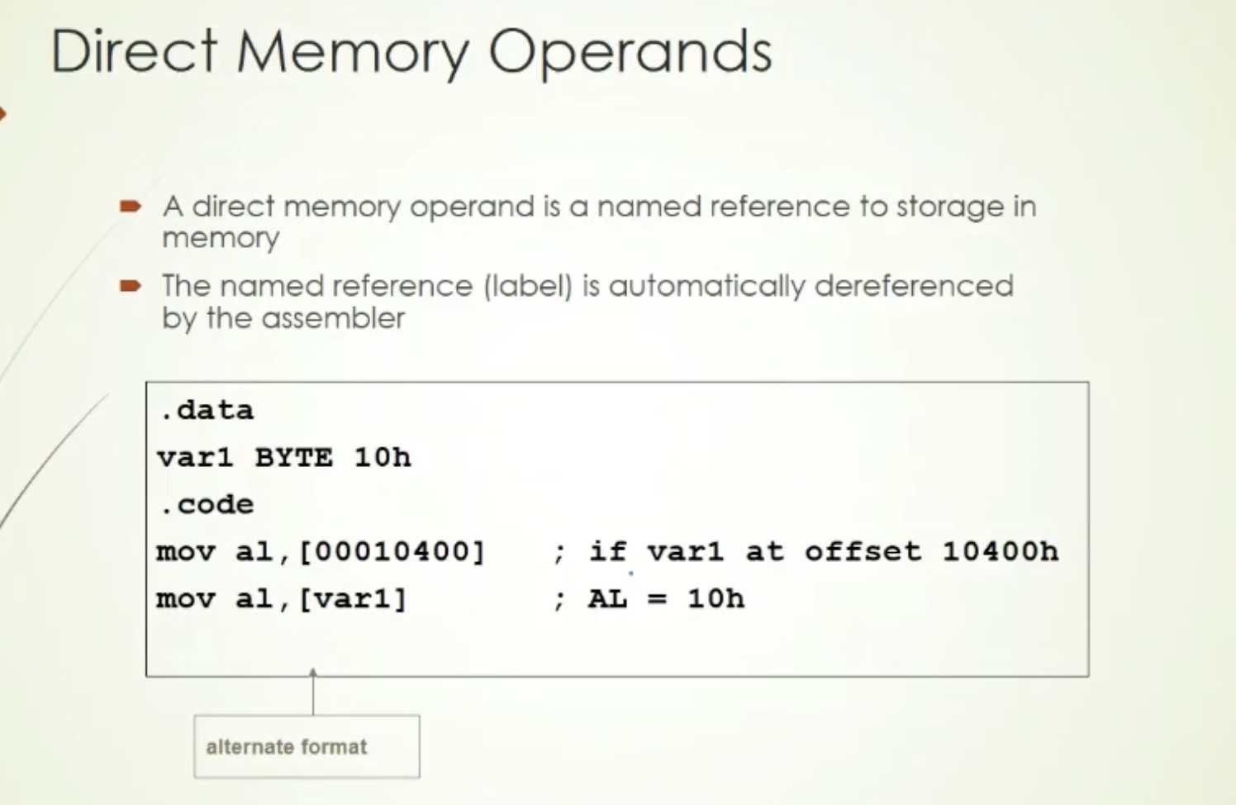

Slide 19
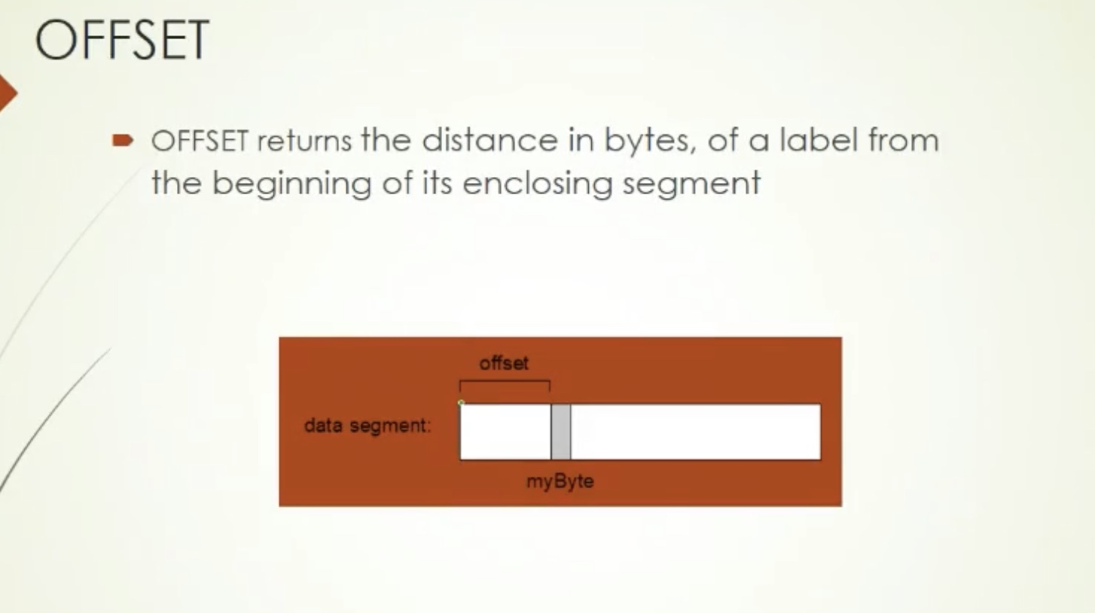

Slide 20
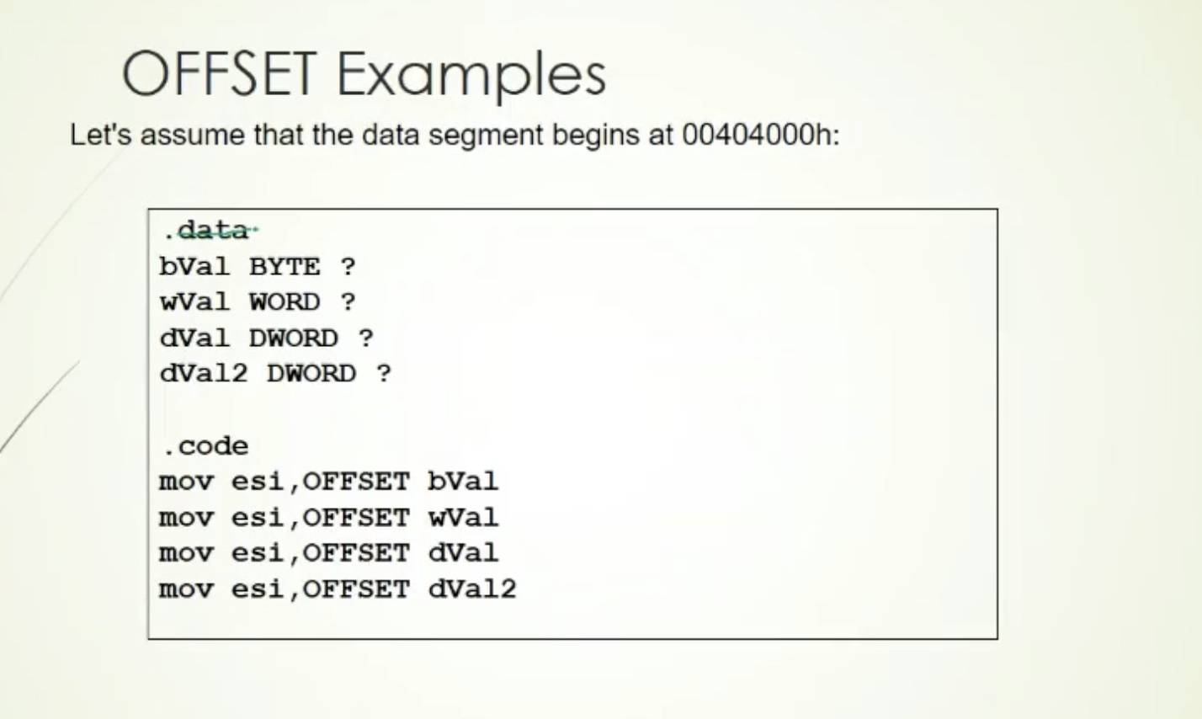

Slide 21
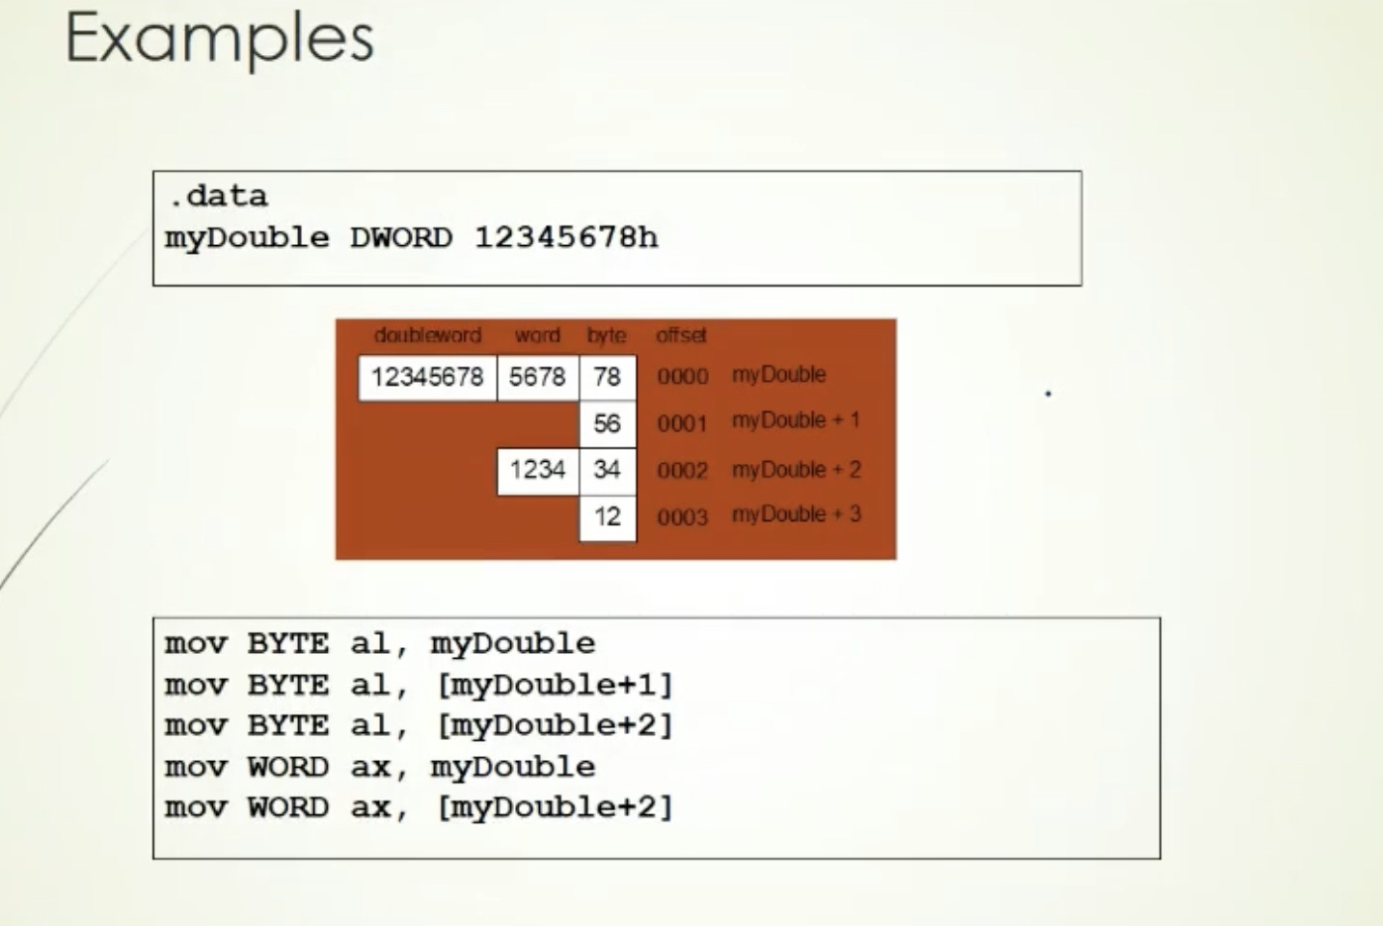

Slide 22
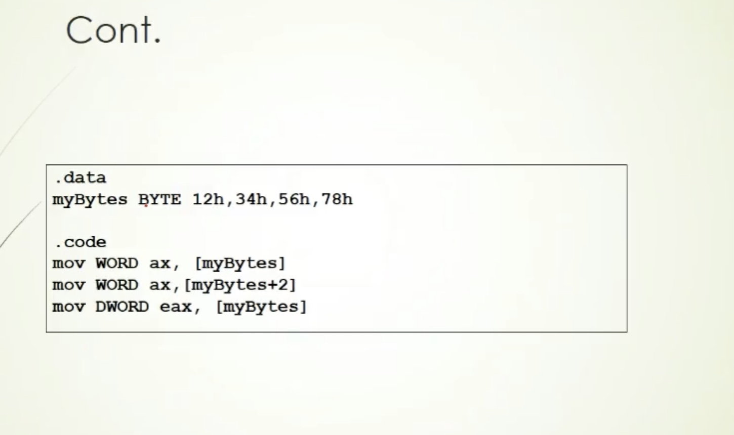

Slide 23
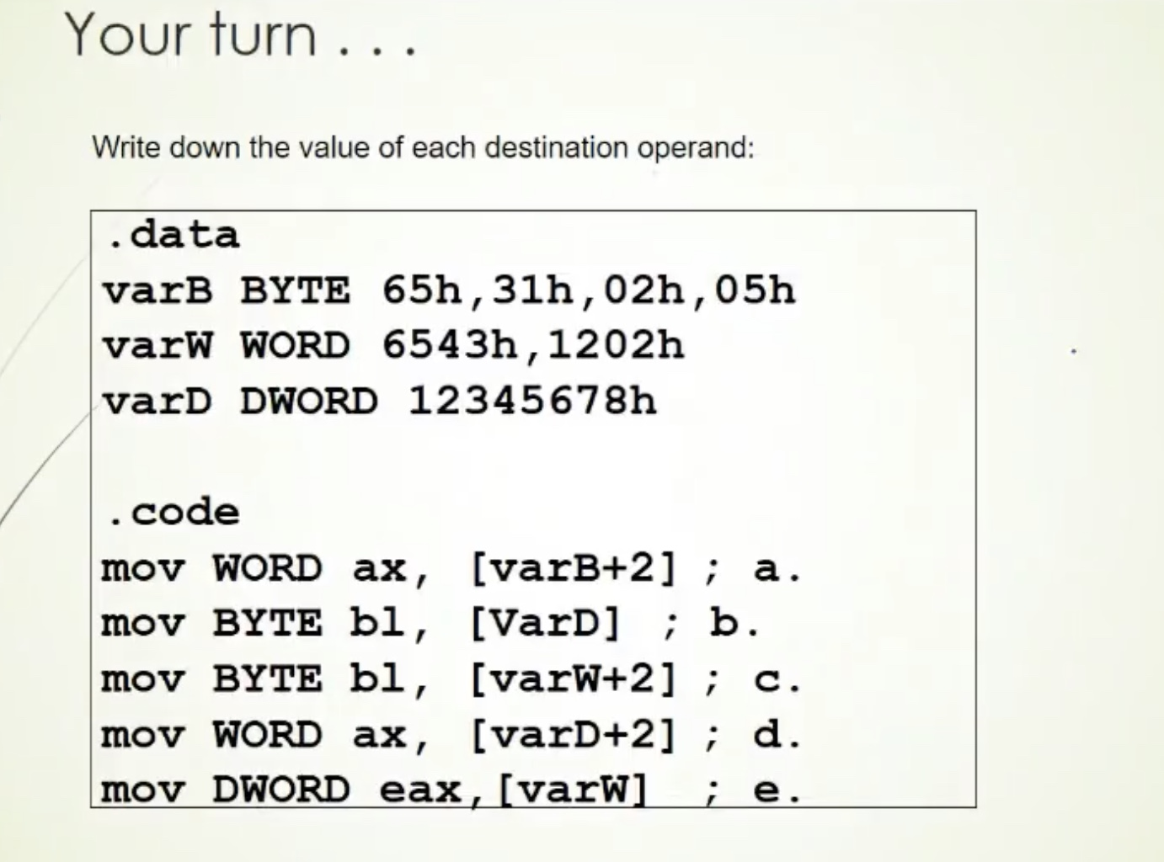

Slide 24
End of Lecture

